Slide 1

.NET OOPS

Slide 2
Agenda
Exception Handling and Exploring Structs
Basic Object Oriented Programming concepts
Abstraction, Interface and Inheritance
Delegates
LINQ
DO NOT WRITE ANYTHING
HERE. LEAVE THIS SPACE FOR
WEBCAM

Slide 3
Exception Handling and Exploring Structs

Slide 4
Exception Handling and Exploring Structs
Exception Handling
A problem that occurs during the execution of a programme is referred to as an exception.
Example: Attempting to divide by zero.
Syntax:
try
{
// Code causing exception case
} catch( ExceptionName e1 )
{
// Code to handle exception
} catch( ExceptionName e2 )
{
} catch( ExceptionName eN )
{
// Code to handle exception
}
finally
{
// statements to be executed
}
DO NOT WRITE ANYTHING
HERE. LEAVE THIS SPACE FOR
WEBCAM

Slide 5
Exception Handling and Exploring Structs
Exception Classes in C#
System.IO.IOException
System.IndexOutOfRangeException
System.ArrayTypeMismatchException
System.NullReferenceException
System.DivideByZeroException
System.InvalidCastException
System.OutOfMemoryException
System.StackOverflowException
DO NOT WRITE ANYTHING
HERE. LEAVE THIS SPACE FOR
WEBCAM

Slide 6
Exception Handling and Exploring Structs
Exploring Structs
Structure is a value type data type in C#.
It allows you to combine relevant data from several data kinds into a single variable.
A structure is created with the struct keyword.
Example:
struct novels
{
public string title;
public string author;
public int book_id;
};
DO NOT WRITE ANYTHING
HERE. LEAVE THIS SPACE FOR
WEBCAM

Slide 7
Basic Object Oriented Programming Concepts

Slide 8
Basic Object Oriented Programming Concepts
Encapsulation
The process of encapsulating one or more elements within a physical or logical container is characterised as encapsulation.
Encapsulation prohibits access to implementation details in object-oriented programming.
An access specifier determines the scope and visibility of a class member. The following access specifiers are supported by C#:
Public
Private
Protected
Internal
Protected internal
DO NOT WRITE ANYTHING
HERE. LEAVE THIS SPACE FOR
WEBCAM

Slide 9
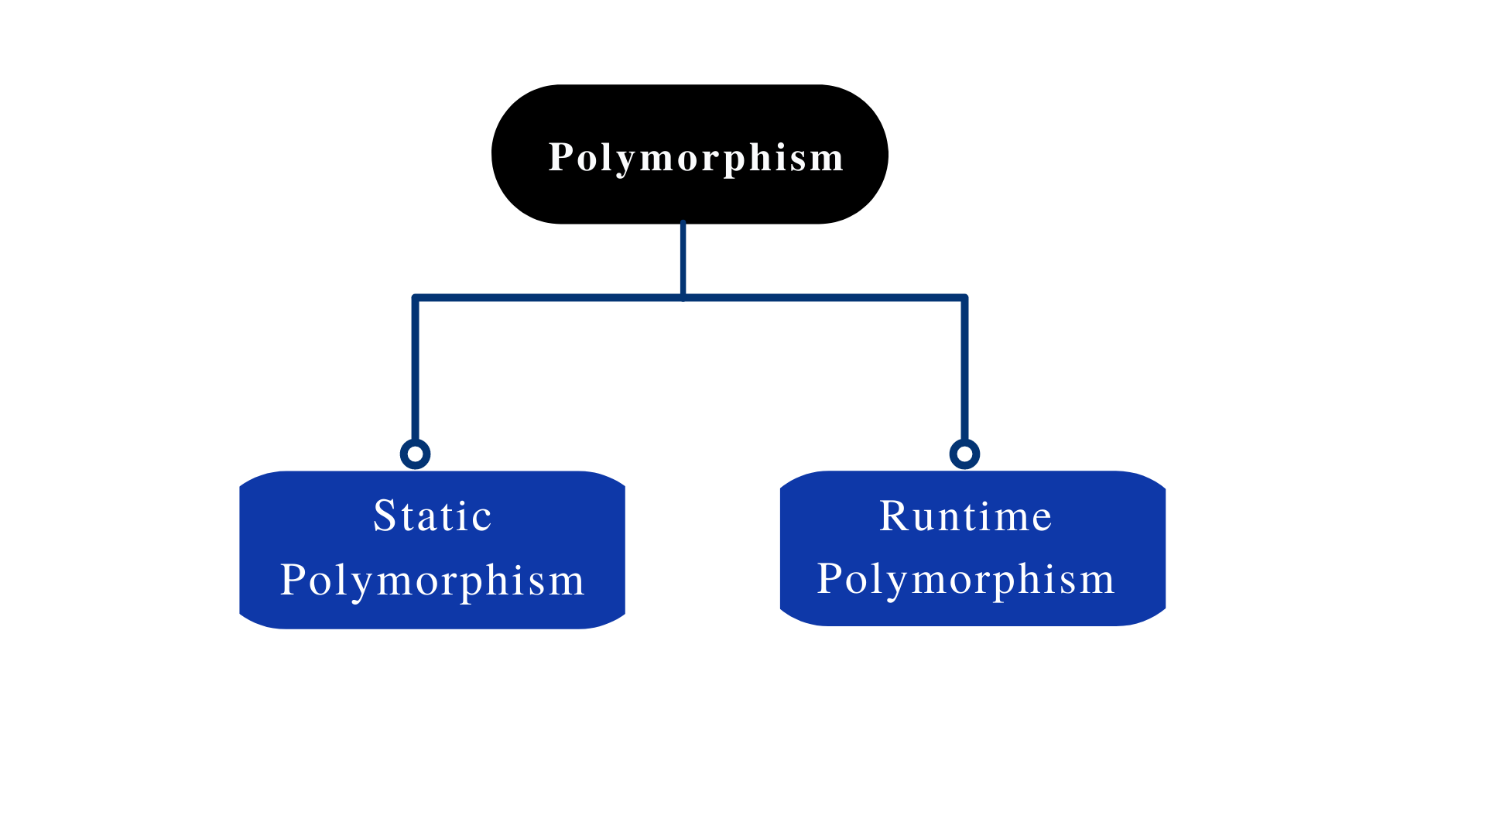
Basic Object Oriented Programming Concepts
Polymorphism
Polymorphism refers to the fact that something exists in multiple forms.
Polymorphism is commonly described in the object-oriented programming paradigm as "one interface, numerous functions."
DO NOT WRITE ANYTHING
HERE. LEAVE THIS SPACE FOR
WEBCAM

Slide 10
Abstraction, Interface and Inheritance

Slide 11
Abstraction, Interface and Inheritance
Abstraction
Abstraction in C# refers to the technique of hiding internal details and simply displaying functionality.
Abstract Method
An abstract method is one that is declared abstract and has no body.
Example: public abstract void write ( );
Abstract Class
An abstract class is one that has been declared abstract. There are both abstract and non-abstract methods that can be used.
It's a class that can't create new objects (to access it, it must be inherited from another class).
DO NOT WRITE ANYTHING
HERE. LEAVE THIS SPACE FOR
WEBCAM

Slide 12
Abstraction, Interface and Inheritance
Interface
An interface is an entirely "abstract class," having only abstract methods and properties (and no bodies)
All the methods are only abstract methods inside an Interface
No method body
No instantiation
Example:
// interface
interface living beings
{
void sleep(); // interface method (does not include a body)
void eat(); // interface method (does not include a body)
}
DO NOT WRITE ANYTHING
HERE. LEAVE THIS SPACE FOR
WEBCAM

Slide 13
Abstraction, Interface and Inheritance
Inheritance
In C#, inheritance refers to the ability to build a class that inherits the attributes and actions of another class.
Derived Class (Child) - a class that is descended from another.
The class being inherited from is called the base class (parent).
Use the : sign to inherit from a class.
Syntax:
<acess-specifier> class <base_class> {
...
}
class <derived_class> : <base_class> {
...
}
DO NOT WRITE ANYTHING
HERE. LEAVE THIS SPACE FOR
WEBCAM

Slide 14
Delegates and Event Handlers

Slide 15
Delegates and Event Handlers
Delegates
Delegate is a reference to a method in C#. In C and C++, it works similarly to a function pointer.
Internally, a delegate declaration specifies a class that is inherited from another class of system.delegate
Syntax:
delegate <return type> <delegate-name> <parameter list>
DO NOT WRITE ANYTHING
HERE. LEAVE THIS SPACE FOR
WEBCAM

Slide 16
Delegates and Event Handlers
Event Handlers
The event is a delegate that has been encapsulated.
Many people can subscribe to an event.
In general, we utilised the Event to represent a single user activity, such as clicking a button.
If the event has many subscribers, the event handler is called synchronously.
Syntax:
public event EventHandler Event_Name;
DO NOT WRITE ANYTHING
HERE. LEAVE THIS SPACE FOR
WEBCAM

Slide 17
LINQ

Slide 18
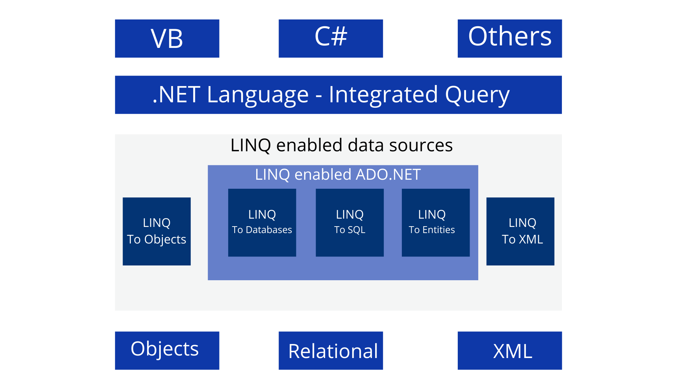
LINQ
In C#, LINQ is used to access data from a variety of sources, including objects, data sets, SQL Server, and XML.
LINQ is abbreviated as Language Integrated Query.
DO NOT WRITE ANYTHING
HERE. LEAVE THIS SPACE FOR
WEBCAM

Slide 19
Summary
How to handle exceptions and also information about structures in C#
Basic OOPs Concepts like Polymorphism, inheritance, abstraction, interface and encapsulation
Creating Delegates and Event Handling
LINQ - Language Integrated Query Structure and uses
DO NOT WRITE ANYTHING
HERE. LEAVE THIS SPACE FOR
WEBCAM

Slide 20
Thank You
Proprietary content. ©Great Learning. All Rights Reserved. Unauthorized use or distribution prohibited

